Slide 1
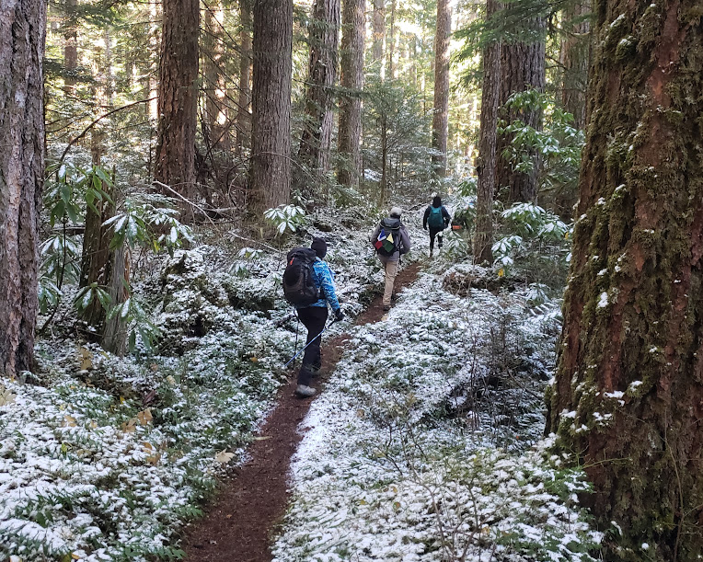
Winter Hiking Series
I-90 Alley

Slide 2
Tacoma Hiking & Backpacking Committee
Hiking/Welcome to Hiking
Backpacking
Baker Weekend
Trail 1st Aid or Emergency Preparedness
Author Events
Fun nights!
  Game Night
  Where in the World?!?
  Try out our favorite dried foods!

Slide 3

Instructor Introductions
Myself – Lisa McPeak
Mike Baker Krys Beard
Neal Stein Carloyn Carbajal
David Hyde Monte Windsor
Linda Shewey Jeryl Kolb
Gene Keltgen David Judish

Slide 4
The philosophy of this course…..
3 rules in this order
SAFETY (physical and emotional)
FUN
GET THE JOB DONE
(Extra Credit: Does anyone know where I borrowed this information from?!?)

Slide 5
Why winter hiking?!?
Pros
Cons
Let’s keep in shape over the winter!
Be ready for the higher elevation hikes when the snow melts.
Difficult to find hikes that are “do-able”
Weather: if not raining it is snowing or maybe doing both
Tread can be less safe
You carry more weight.

Slide 6

Course and hikes in general …...
Not a course for beginner hikers.
At least 6 miles and 1500 elevation with 1.5 to 2.5mph average moving speed.
Unlike CHS there is no progression, and some hikes are generally lower elevation and shorter, but others are a few that are 10 miles and about 2600 feet which meets the requirement of a Tacoma CHS graduation hike.
LOOK AT EACH HIKE CLOSELY BEFORE SIGNING UP.
  Look closely at the length and distance since to get the distance in many hikes are not being done at the standard way.
  The hike descriptions may give you a better idea of what is really happening.
  Many leaders changed the pace to better match what they do.
  AN EXAMPLE:
  January 14 Little Si and Boulder Garden HIke

Slide 7
What we are all responsible to carry….

Slide 8
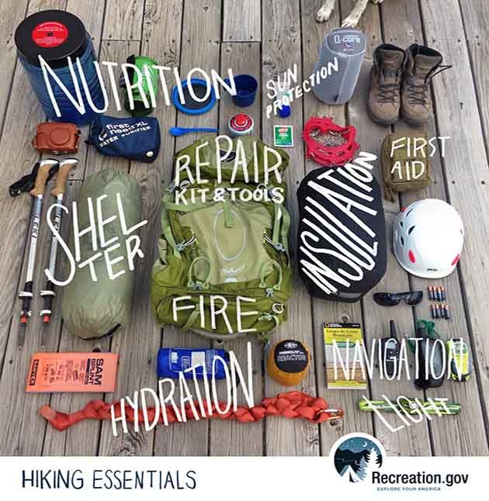
Ten Essentials
***for all weather hiking*** https://www.mountaineers.org/blog/what-are-the-ten-essentials
1. Navigation
2. Illumination
3. Sun Protection
4. First-aid Kit
5. Repair Kit and Tools
6. Fire
7. Shelter
8. Hydration
9. Nutrition
10. Extra clothes
Notes:
LARA
1. Navigation - Map and compass are required as well. If you don't know how to use them, take a class () or ask some of your more experienced hiking companions to demonstrate.
2. Illumination - Bring along that flashlight or headlamp (and extra batteries); you may be delayed getting off the trail, and it's a lot easier with a light source. The benefit of the headlamp is that it leaves your hands free to use to use trekking poles, see a compass or administer first aid in the dark.
3. Sun Protection - Sunglasses and sunscreen to protect your eyes from bright sunlight or reflection off of snow and glaciers. A broad-brimmed hat and loose-fitting lightweight clothing with long sleeves and long pants legs can also help prevent sunburn.
4. First-aid Kit - Containing items for treating common trail injuries such as cuts, scrapes, blisters, etc.
5. Repair Kit and Tools - A pocket knife is handy for many uses such as preparing lunch, cutting bandages, preparing a fire, etc. Extra shoelaces, a bit of duct tape wrapped around a water bottle or trekking pole and perhaps some safety pins.
6. Fire -Waterproof matches and fire starter to start an emergency fire.
7. Shelter – A tarp or large garbage bag can be used as an emergency shelter in a pinch. If your return is waylaid for any reason and you are stuck overnight in the mountains, your shelter will help to keep you out of inclement conditions until help arrives.
8. Hydration - Bring plenty of water - at least a liter of water for a five-mile trip, more for a longer trip.
9. Nutrition - Bring plenty of food to fuel those working muscles and keep your body warm and comfortable.
10. Extra clothes - Bring along extra clothing for insulation. Remember you lose 3-5 degrees of temperature for every 1,000 feet of elevation gain. Remember the layering system for staying comfortable: base layer (against your skin to wick away moisture), insulation layer (to trap warm air near your body), and shell layer (when needed for protection against wind and/or rain).

Slide 9

But there are….
Winter hiking MUST HAVES in our pack or on our body
***MICROSPIKES***
We do not stop a hike because of a little snow (but not Yaktrax)
LAYERS, LAYERS, LAYERS and NO COTTONS AT ALL!!!
Consider: Trekking Poles

Slide 10
Trekking Poles
Pros
Cons
Help with balance especially in the snow
Slows you down when needed
Yet can also make you faster
Extra weight
Safety risk if not using correctly
  Not always putting them in ground
  Putting too much weight on them when they are not stable
  Using them to “pull you up the mountain”

Slide 11
Now let’s talk weather!

Slide 12
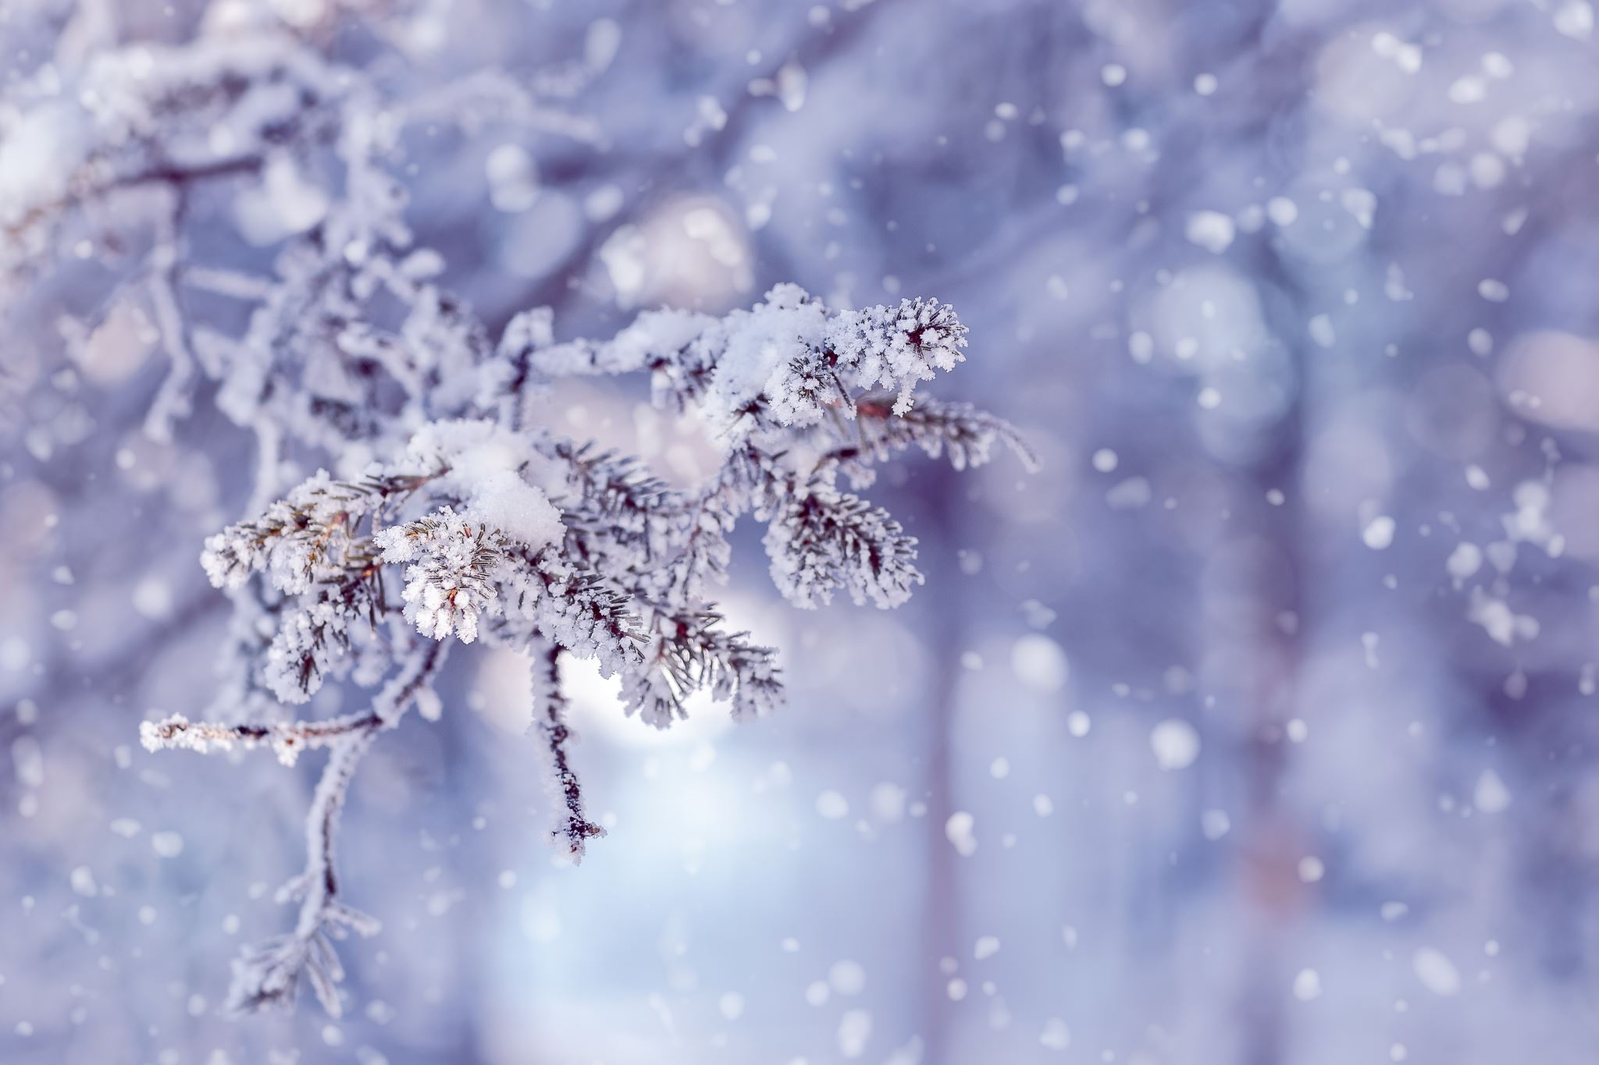
Weather related thoughts
Plans can change quickly and even the morning of the hike. You always need to review the weather websites and your emails before you leave.
Hikes are not cancelled for just miserable weather; they are cancelled for dangerous weather.
Hikes can also be changed to other lower elevation sites in the area if the higher elevations are not safe.

Slide 13
When do we cancel or change the hike for weather?!?
****Unsafe driving conditions to the trailhead***
Snow so deep that it really should be a snowshoe. General Rules: snow greater than 6 inches or above midcalf; too much ice
Leader may change the hike to a lower elevation if possible and/or do the hike up to the safe point and turn around. (This will be considered a complete hike if there is a turn around for safety.)
Hike cancellation and/or change of hike site is up to the individual leader.

Slide 14
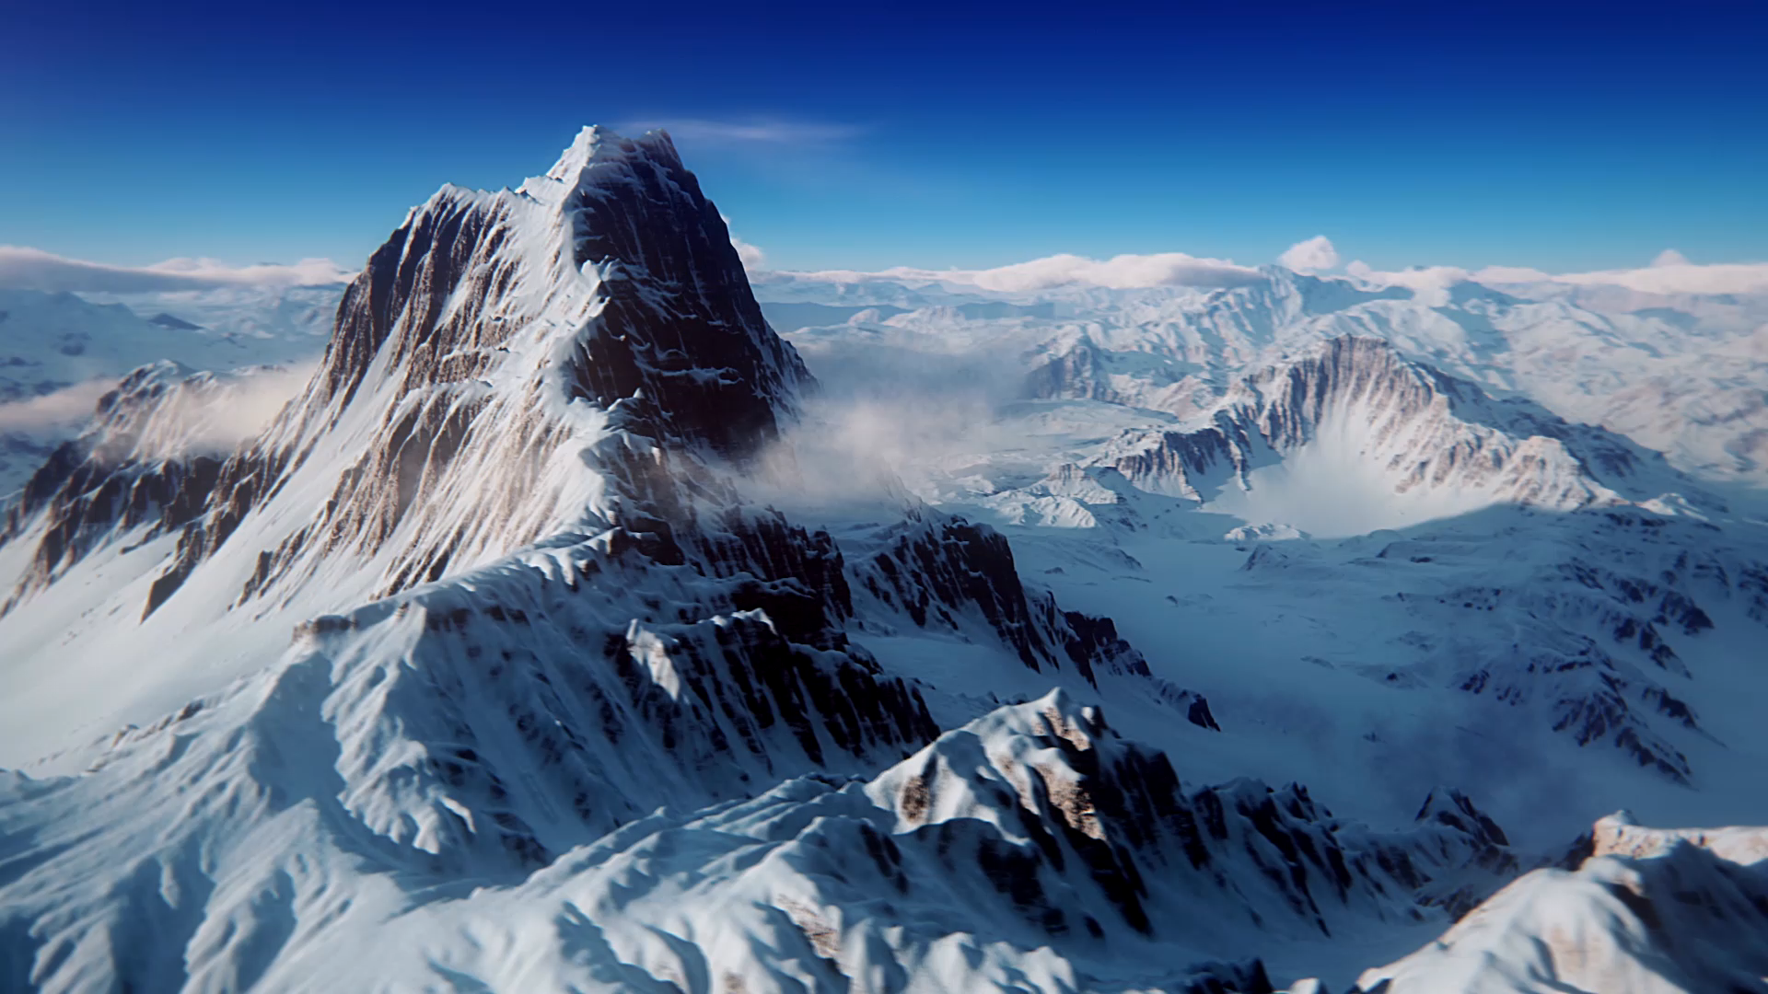
Weather Websites: Lets go to them!!!
NOAA
https://forecast.weather.gov/Issaquah
https://forecast.weather.gov/North Bend
https://forecast.weather.gov/Bellevue
MOUNTAIN FORECAST: the one for Mt. Si
https://www.mountain-forecast.com/Mt Si

Slide 15
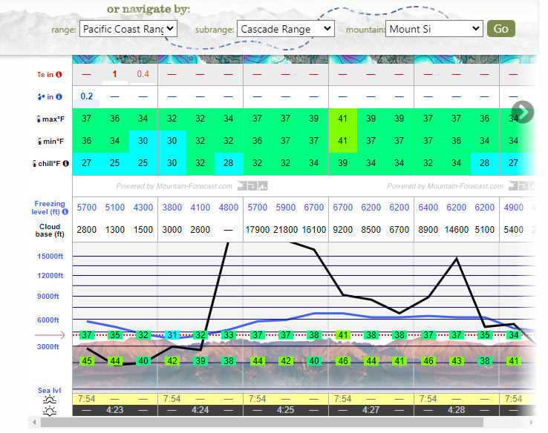

Slide 16
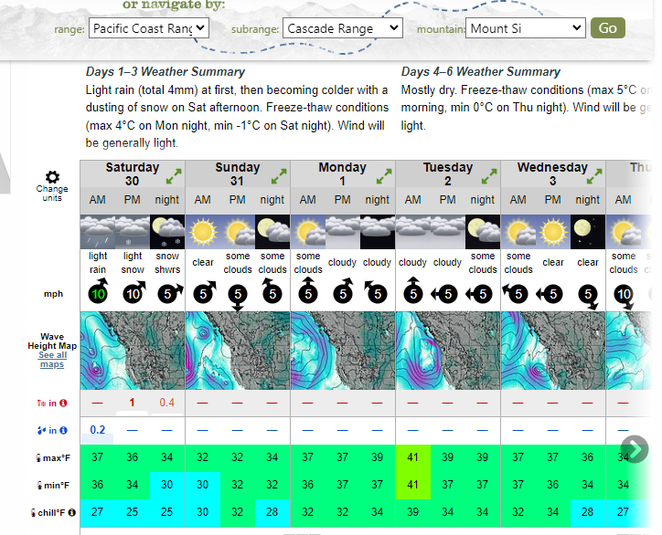

Slide 17
Do you want to learn these hikes?
Consider getting some maps and maybe explore a little on your own and/or hike with others outside of the course.
GAIA does not have all the trails on these mountains listed so sometimes you need a map to follow. (Maps do not have it all either and that is why hiking in these mountains is fun!)
Also I hike 2 times a week and love others to come along; this is my typical winter hiking area. You can come with me or look for others to help explore!
GREENTRAILS MAPS FOR THOSE INTERESTED: Cougar and Squak (203S), Tiger (204S), Rattlesnake (205S), Mt Si (206S) but tell me if I missed one.

Slide 18
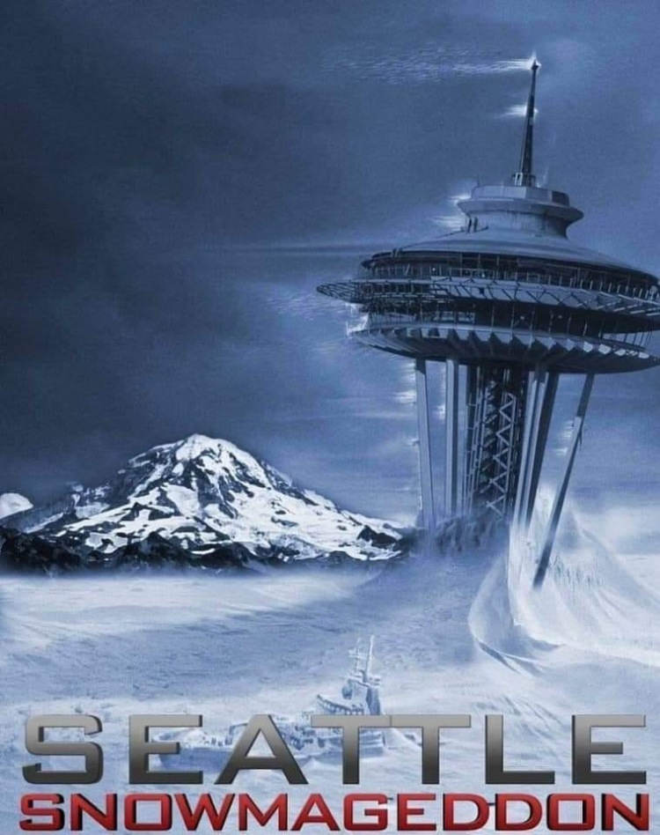
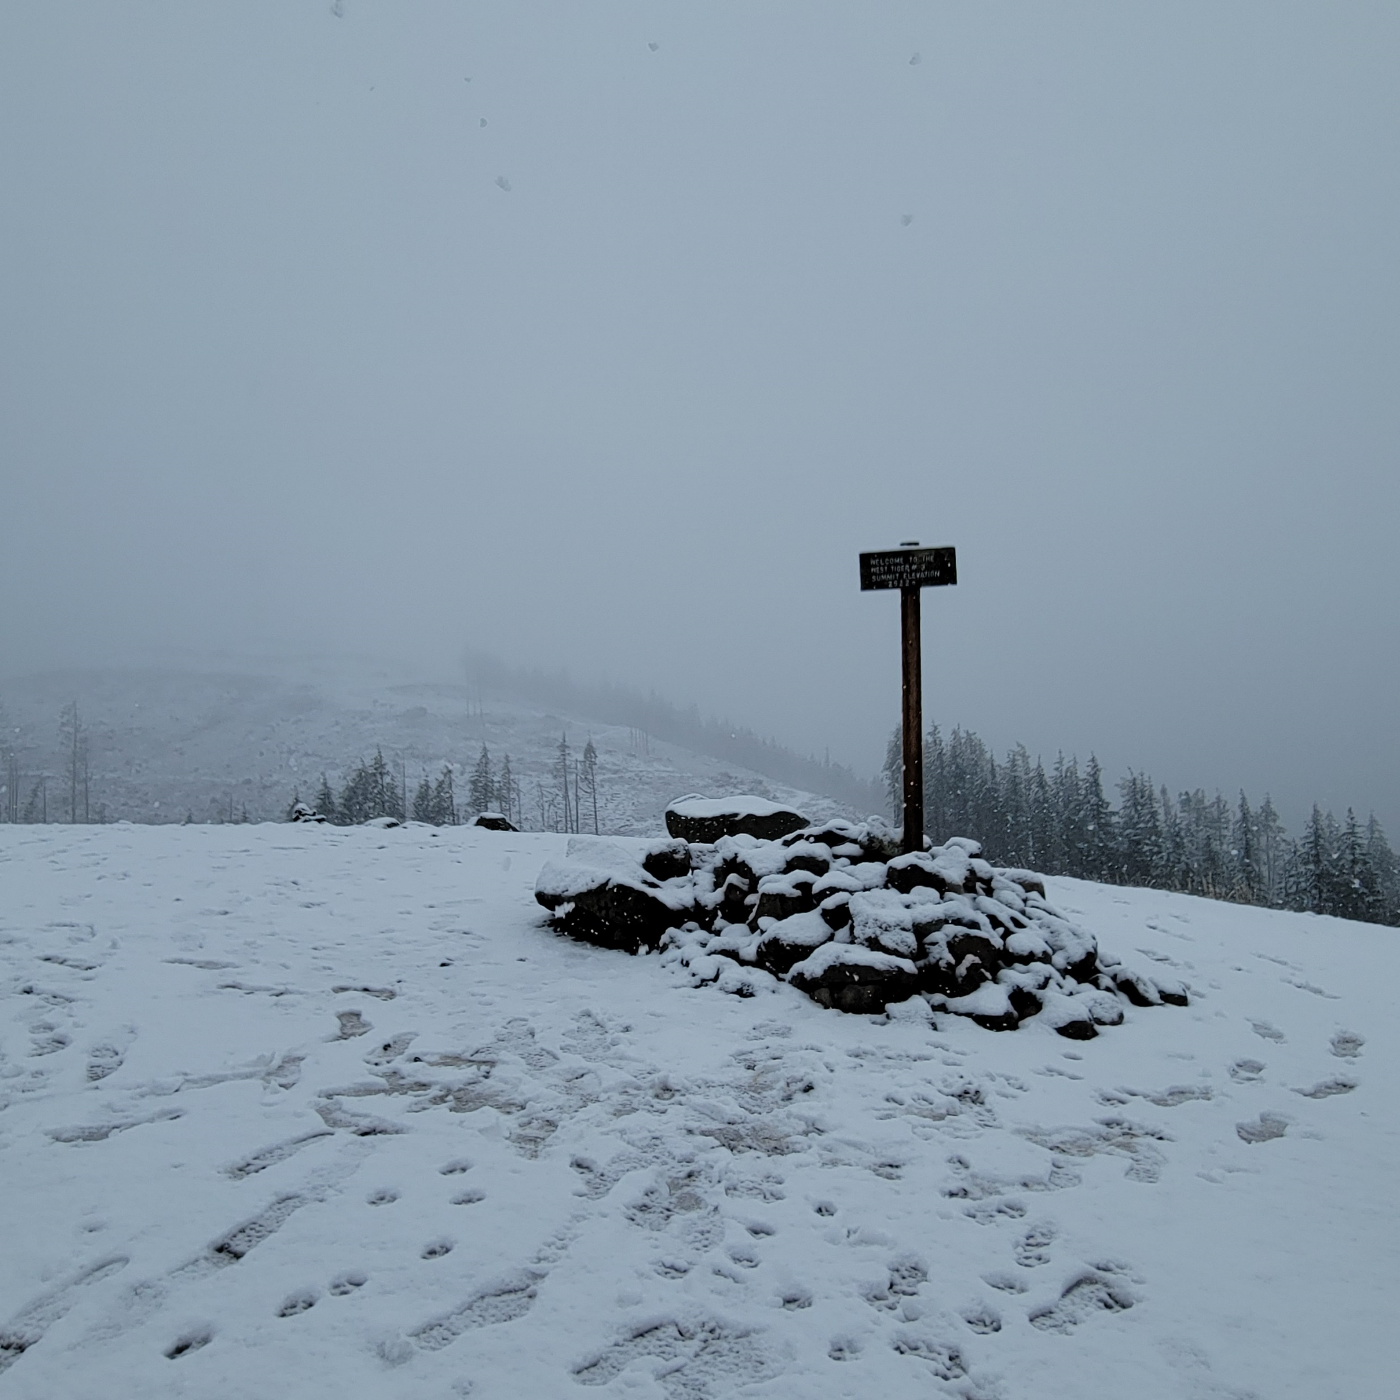
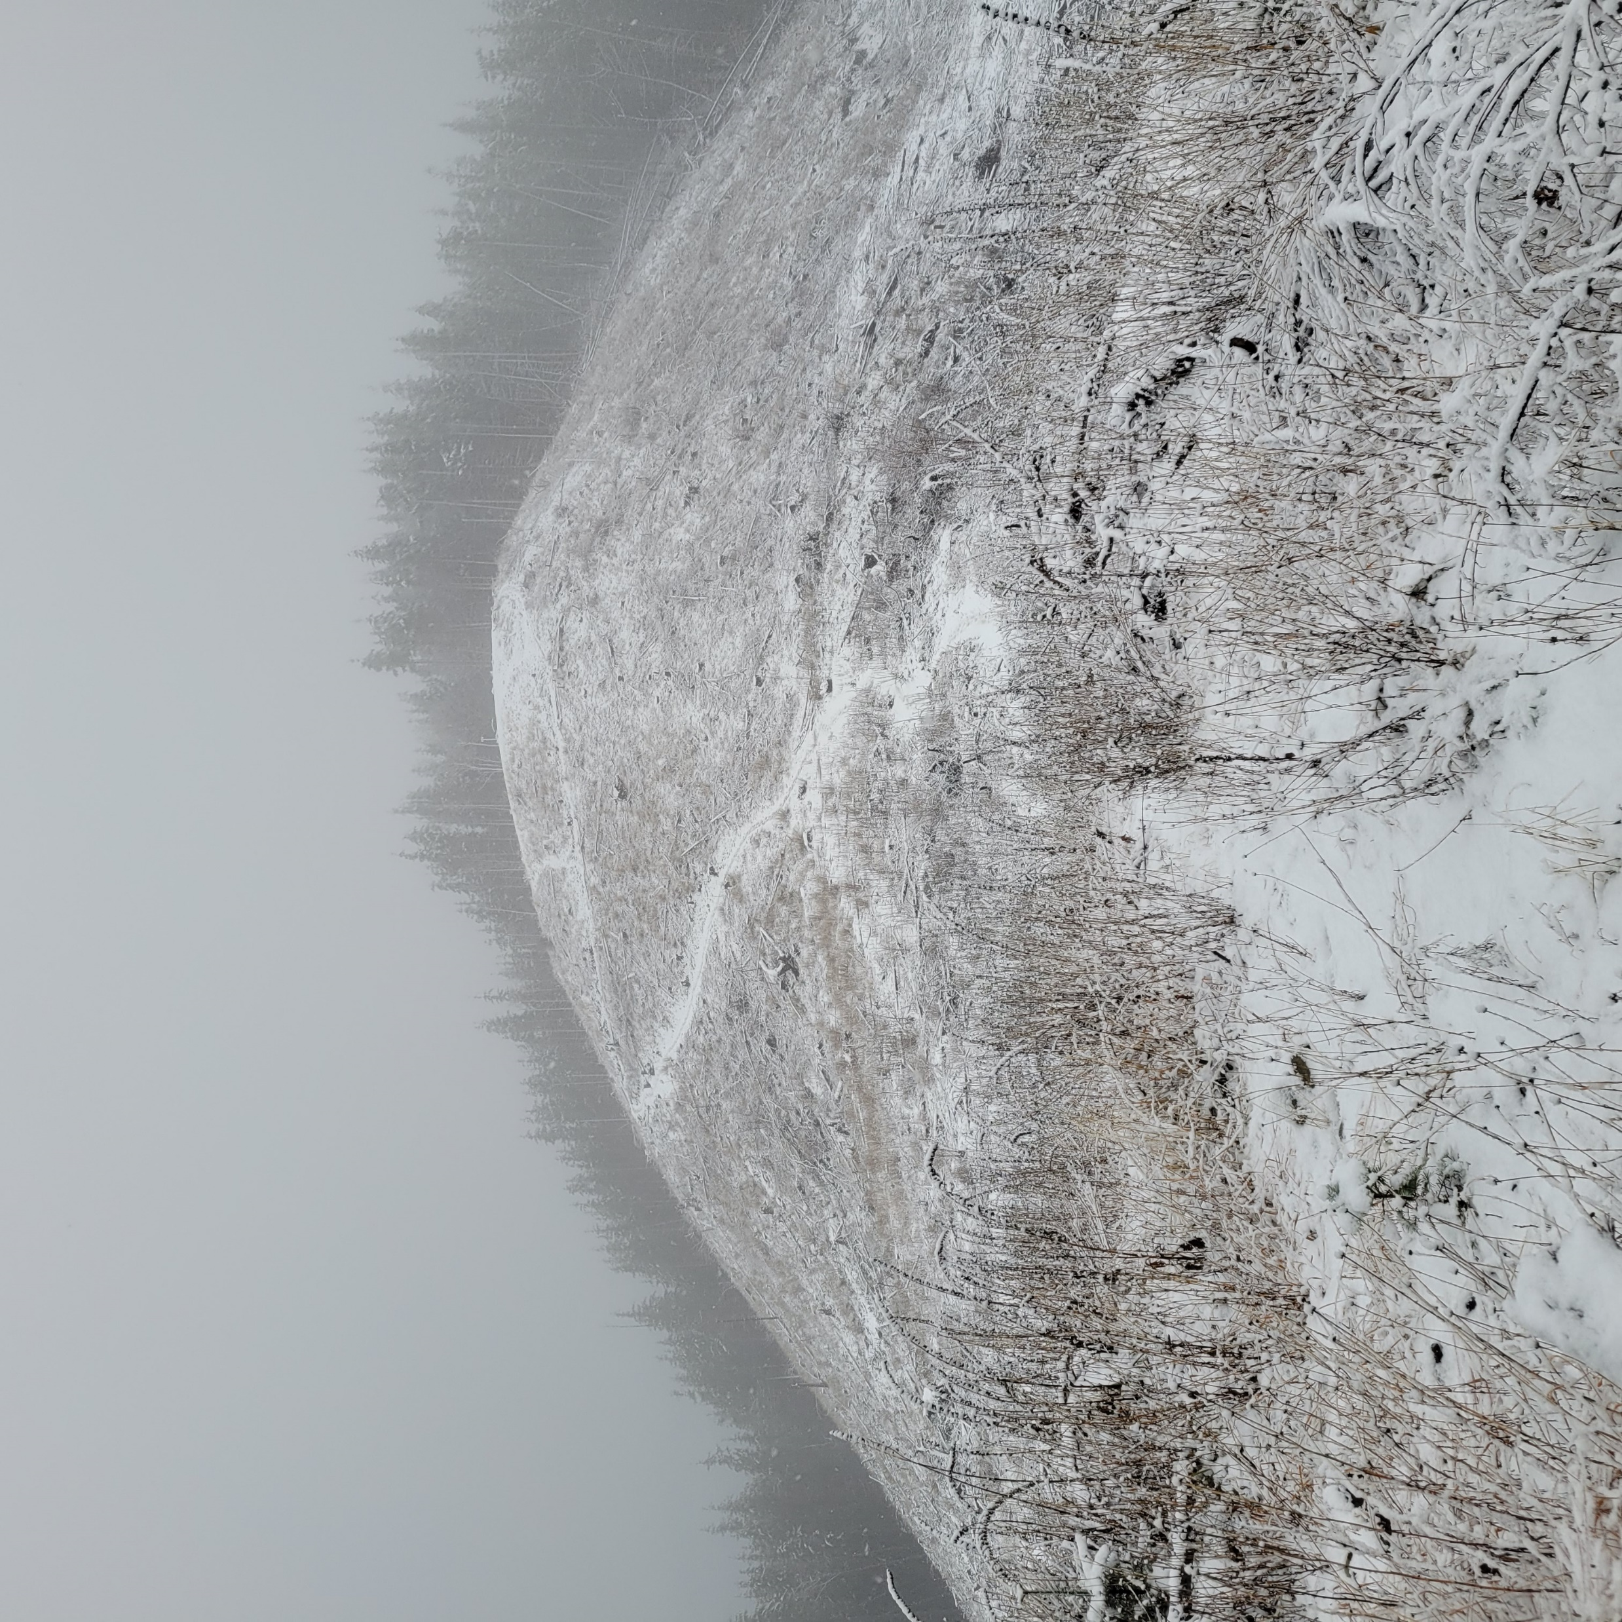
Lessons Learned: 2 hikes
“Snowmageddon” Feb 2019
December 22, 2023

Slide 19
The boring part…. The nuts and bolts of the course…..

Slide 20
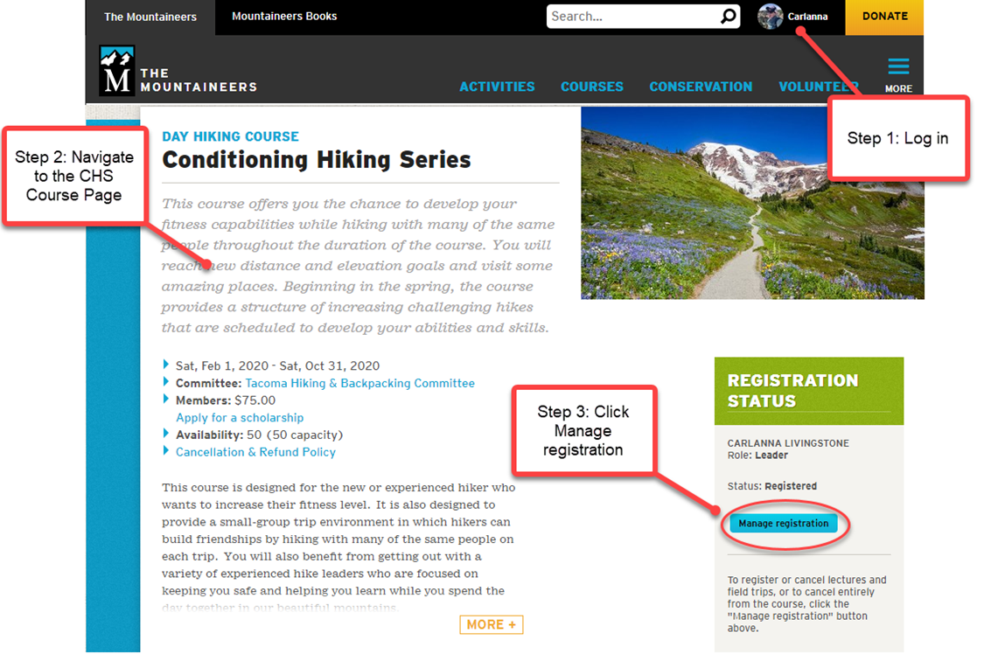
How to register….
Using the CHS slides but it’s the same except the course name!

Slide 21
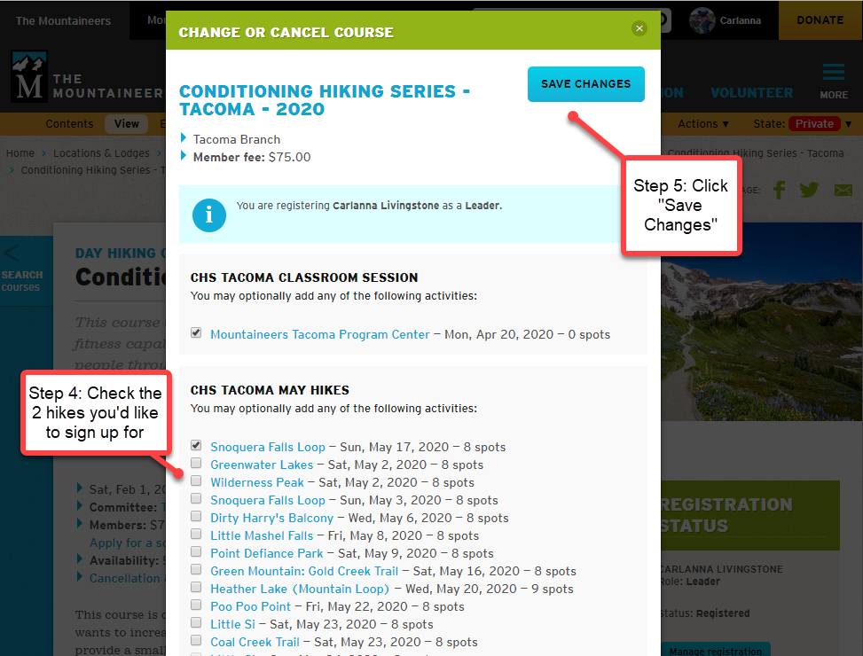
Again, using the CHS slides but it’s the same except the course name!

Slide 22
Written out instructions too! (on computer*)
Log into your account
Sweep over your icon on top right, go to - My Courses & Programs, and click on it to open
Then click to open up this course - Winter Hiking Series: I-90 Alley
Under Registration Status on the right click on - Manage Registration
Click on the hike you would 2 like to choose when registration opens up for January/February/March (see next slide)
Click “Save Changes” on top right and be patient.
*interface on your cell or mobile device looks REALLY different so will have to look for areas to click in different places; often at the bottom.

Slide 23
When can I register?
January Hikes
OPEN FOR YOU TO RESGISTER FOR 2 HIKES: Friday Jan 5th at 8am
OPEN FOR YOU TO REGISTER FOR MORE THAN 2: Monday Jan 8th at 8am
EACH HIKE OPEN TO ALL IN MOUNTAINEERS: 7 to 10 days before each hike
February and March Hikes
OPEN FOR YOU TO RESGISTER FOR 2 HIKES: Jan 15th at 8am for February hikes; Feb 15th at 8am for March hikes
OPEN FOR YOU TO REGISTER FOR MORE THAN 2: Jan 22nd at 8am for February hikes and Feb 22nd at 8am for March hikes
EACH HIKE OPEN TO ALL IN MOUNTAINEERS: 7 to 10 days before each hike

Slide 24
Cancellations
ONLY sign up for Hikes YOU INTEND TO DO.
If you’re thinking about signing-up for a trip that you know might be a stretch - contact the trip leader before registering.
Most Mountaineers’ trips take place rain or shine, unless otherwise noted by the leader.
Last minute cancellation affects both leaders and trip participants.
Volunteer leaders have made a commitment to you, and to The Mountaineers’ community by posting this trip - and they hope and expect that you will do the same!
Notes:
Megan

Slide 25

Student Responsibilities:
Be on time
  10 minutes early to carpool location/trailhead to leave on time
Be prepared
  Ten Essentials, well fed, well hydrated
Be Flexible
  Don’t schedule anything after a hike
Sign up for hikes you plan to do – Please limit Cancellations
Notes:
Megan

Slide 26

Carpooling
Be prepared
  Offer to pay driver!
  Recommend $0.12/mile 1-2 passengers
  Recommend $0.24/mile divided by 3+ passengers
Ask before eating in vehicle
Bring a plastic bag for wet/muddy items
Notes:
Megan
Current State
Carpooling with household members is encouraged. Carpooling with non-household members is not recommended.
Pre/Post Covid
Try to pre-arrange carpool
Be prepared
Offer to pay driver!
Recommend $0.12/mile 1-2 passengers
Recommend $0.24/mile divided by 3+ passengers
Ask before eating in vehicle
Bring a plastic bag for wet/muddy items

Slide 27
Trail Etiquette
Be nice to others
Yield to Uphill traffic
Step to the uphill side of the trail and face the trail
Stay to the right on wider paths
Pass on the left
Keep noise levels low
Practice “Low Impact Recreation”
Stay on the trail
Walk through puddles, unless you can do so without going off trail
Notes:
Megan
Be nice to others
Yield to Uphill traffic. Sometimes uphill hikers will prefer to stop and let you pass coming down so they can get a short break. The uphill hiker should get to make the call.
When yielding, step to the uphill side of the trail and face the trail for safety EXCEPT when yielding to horses or other pack animals – then step to the downhill side.
Stay to the right on wider paths.
Pass on the left.
Keep noise levels low
Practice “Low Impact Recreation”
Stay on the trail. Do not cut switchbacks or take shortcuts.
Walk through the mud or puddle and not around it, unless you can do so without going off the trail. Walking round the puddle may widen the trail.

Slide 28

Graduation Requirements
Pretty simple…….
*2 hikes a month that meet the requirements in general (at least 6 miles/1500 elevation)
*At least 1 within the course per month
*If you do another one outside of the course that cannot be viewed on the website, please send an email with the track including elevation and distance to me (Lisa McPeak)

Slide 29

Communication and Questions
Ask Any questions!!
Ask your trip leaders about gear, techniques to use with hiking poles, elevation gain, boots, etc. They love it!
Ask your course leader questions!
Ask your fellow hikers questions – we all love to talk gear and share what we have learned!
Notes:
Marilyn

Slide 30

Course Feedback
During the course, If you have a concern about an individual – speak to your trip leader or contact the course leader.
If you have suggestions for improvement, please share with your course leaders.
If you have a wonderful experience, please share.
If there is something that needs improvement, please share.
After the course is completed, you will receive a request for your feedback. Please complete that. Your comments and suggestions are read and make a difference!
Notes:
Megan
During the course, If you have a concern about an individual – speak to your trip leader or contact the course leaders.
If you have suggestions for improvement, please share with your course leaders.
If you have a wonderful experience, please share.
If there is something that needs improvement, please share.
After the course is completed, you will receive a request for your feedback. Please complete that. Your comments and suggestions are read and make a difference!

Slide 31
Expectations:
Notes:
Megan
The Mountaineers does not allow harassment of any kind by one member towards another including harassment based on gender, sexual orientation, race, color, national origin, religion, age, disability, marital or veteran status.
The Mountaineers does not tolerate harassment by one member towards another whether the member is a leader, volunteer, trustee, or officer.

Slide 32
A few last thoughts about this hiking series……
In general, we all hike together and end together so when you can PLEASE HAVE FUN and socialize!!!
This is also your time to think about why you want to hike or if there is something you want to accomplish when you hike.
FOR EXAMPLE…..

